Slide 1
AIR QUALITY INDEX
ANALYSIS
Under the guidance -
Dr. Pon Harshavardhanan

Slide 2
Group Members
Anjeleen Tirkey - 20MIP10048
Devarakonda Anuhya - 20MIP10024
Sidharth ES - 20MIP10015
Sundar N - 20MIP10003
Parthiv JP - 20MIP10036

Slide 3
Objective / Problem Statement
The goal of this project is to collect the data related to the Air Quality Index (AQI) from different air quality monitoring stations across Madhya Pradesh.
Air quality index (AQI) is used by government agencies to communicate to the public how polluted the air currently is or how polluted it is forecast to become AQI calculations focus on major air pollutants, including particulate matter, ground-level ozone, sulfur dioxide (SO2), nitrogen dioxide (NO2), and carbon monoxide (CO). Particulate matter and ozone pollutants pose the highest risks to human health and the environment.

Slide 4
Objective / Problem Statement
The most critical objective of data collection is ensuring that information-rich and reliable data is collected for statistical analysis so that data-driven decisions can be made for research.
We have collected the data from the website for 2 cities in Madhya Pradesh ie, bhopal and mandideep.

Slide 5
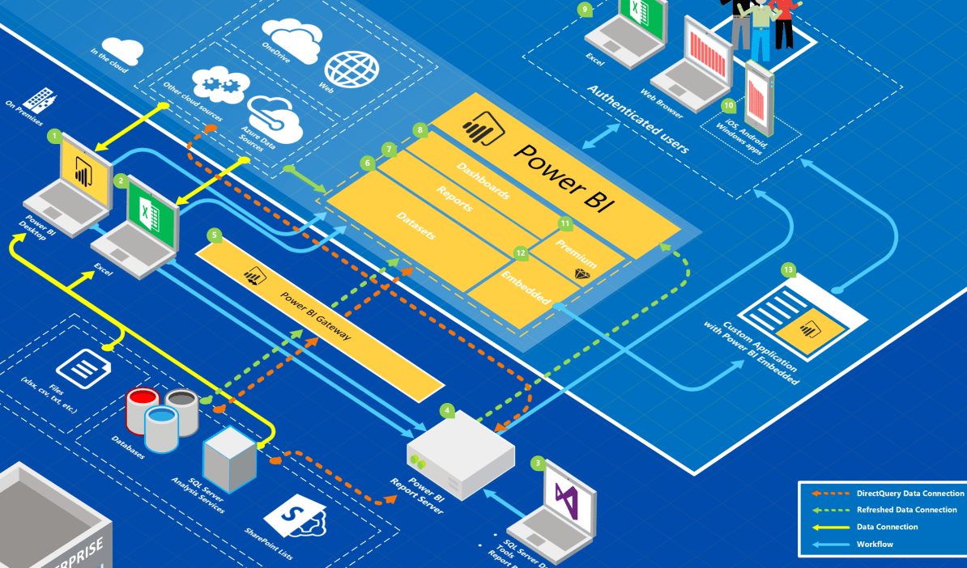
Overall System Architecture

Slide 6
Module Split-Up
Data Collection
In this step we initially collect all the required data from a local server or an online website (any authentic source), then store it into a database for further pre-processing of the data.
This includes getting the data from the Air Quality Index monitoring stations and storing it so that it can further be processed and used for analysis.

Slide 7
Module Split-Up
Data cleaning is the process containing the following steps:
Data cleaning: it is the process to remove incorrect data, incomplete data and inaccurate data from the datasets, and it also replaces the missing values.
Data integration: The process of combining multiple sources into a single dataset.
Data reduction: This process helps to reduce storage space.
Data Transformation: The change made in the format or the structure of the data.

Slide 8
Module Split-Up
Data Pre-processing
Import all crucial libraries and
Import the dataset
Extracting independent & dependent variable
Identifying and handling the missing values
Encoding the categorical data
Splitting the dataset - Training & Test set
Feature scaling

Slide 9
Module Split-Up
Power BI - Power BI helps one use them in a sort of ecosystem, to consume business insights in a way that serves them the best. Usually, a report is created on the Power BI desktop, it is then shared across the Power BI service so that other members of the team can use/ view them.
Users who are on the move can also view them on the Power BI mobile applications. The dashboards and reports are very easily shared, and thus it is very easy for people on the team and external stakeholders (if any) to view them.

Slide 10
Module Split-Up
Power BI provides a great variety of taking the input data, one of them being excel sheet.
The locally downloaded merged data of the cities were loaded into the Power BI Desktop.
Connect Power BI to multiple data sources to create reports.
Create and customize visuals to present data in compelling and insightful ways.
Using the Power BI Dashboards comprehensive visuals are created for better understanding of the data.

Slide 11
Module Split-Up
Power BI
Dashboards will help your users target report visuals to meet their specific needs.
Also learn how to use key performance indicators (KPIs)
Performance optimization, also known as performance tuning, involves making changes to the current state of the data model so that it runs more efficiently can also be performed.
Essentially, when your data model is optimized, it performs better.

Slide 12
Module Split-Up
Data analysis in Power BI
We used Power BI to perform data analytical functions, how to identify outliers in your data, how to group data together, and how to bin data for analysis.
We also learnt how to perform time series analysis. Finally, we worked with advanced analytic features of Power BI, such as Quick Insights, AI Insights, and the Analyze feature.
Additionally, we sorted data and how to present the report in a cohesive manner.
You became competent on how to get a statistical summary for the data and export data from Power BI.
We also performed advanced analytics on the report for deeper and more meaningful data insights.

Slide 13
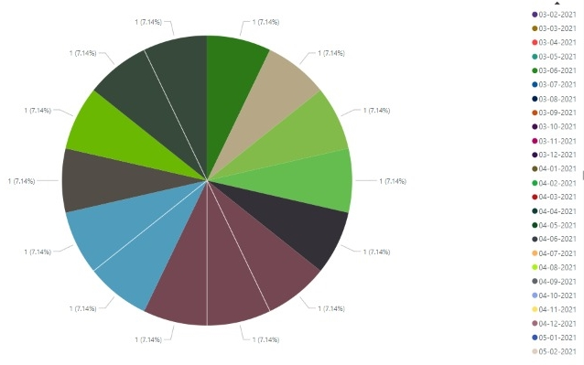
Demo
Figure 1. Wind Speed - Ozone

Slide 14
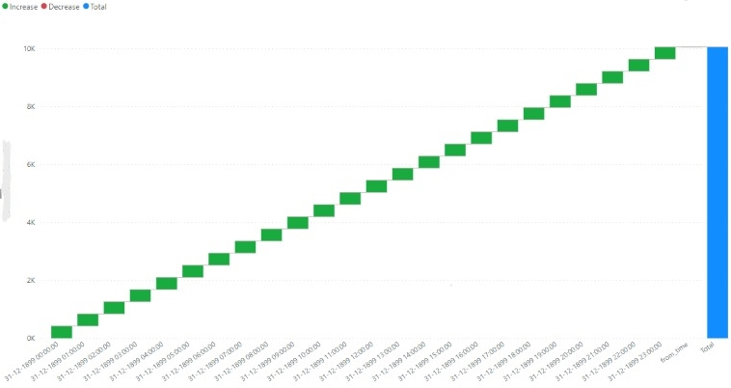
Demo
Figure 2. Wind Speed

Slide 15
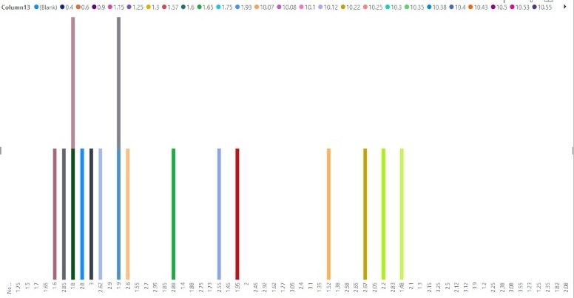
Demo
Figure 3. NO2, NO, O3 comparison

Slide 16
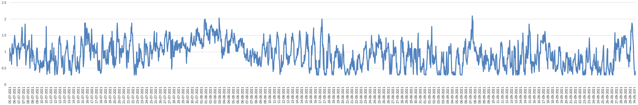
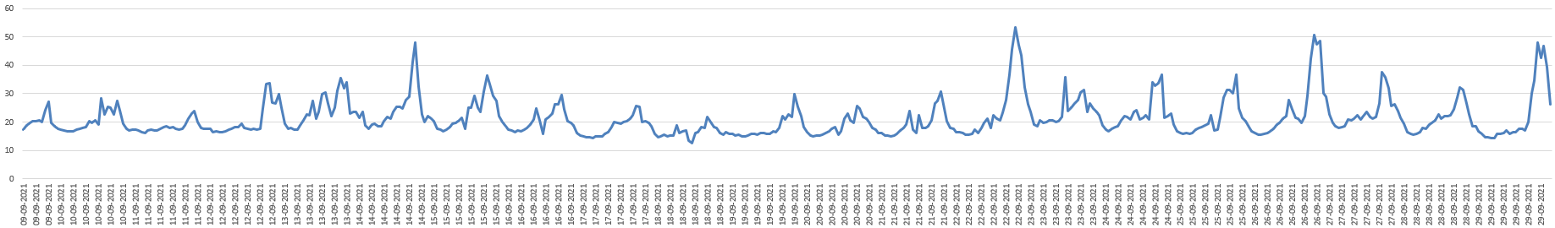
Demo
Figure 4. Wind Speed - NO2

Slide 17
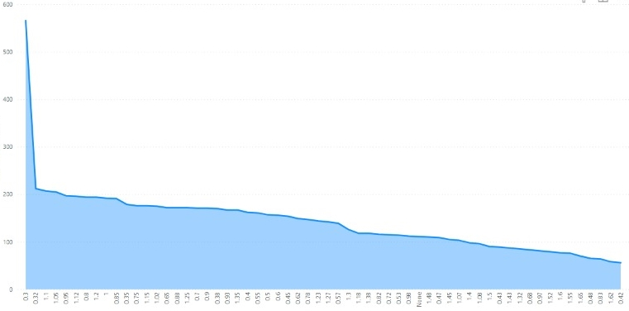
Demo
Figure 5. Wind Speed - Wind Direction

Slide 18
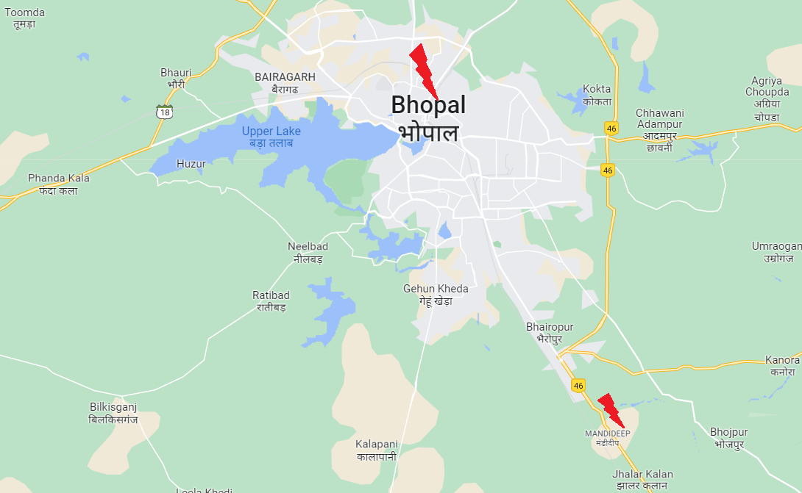
Demo
Figure 6. Map

Slide 19
Thank You

